Slide 1
SIGGRAPH Asia: Neural Prefracture
Presenter: Kim Seung Hwan (overnap@khu.ac.kr)

Slide 2
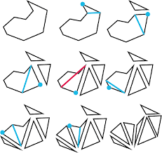
Real-time 3D Object Destruction
Destroy mesh into the small fragments
Realistic & Real-time
Mainly used in games

Slide 3
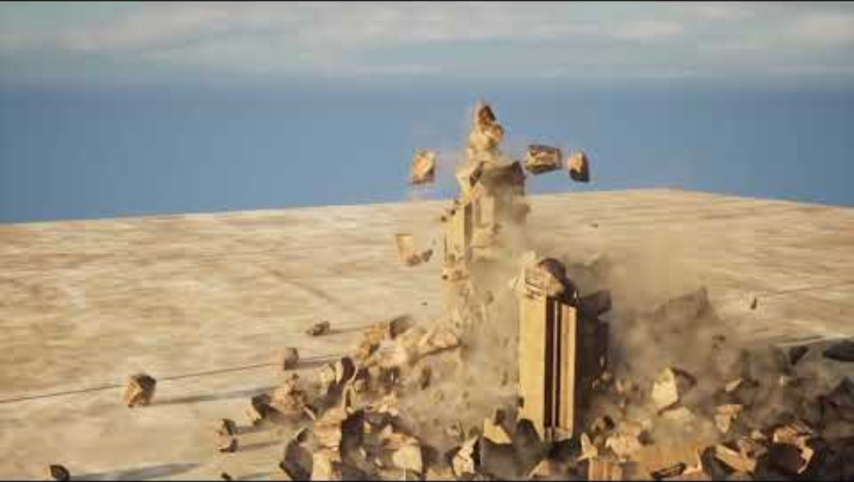
Real-time 3D Object Destruction

Slide 4
Real-time 3D Object Destruction
Realism vs. Computational Cost
They will be the trade-off

Slide 5
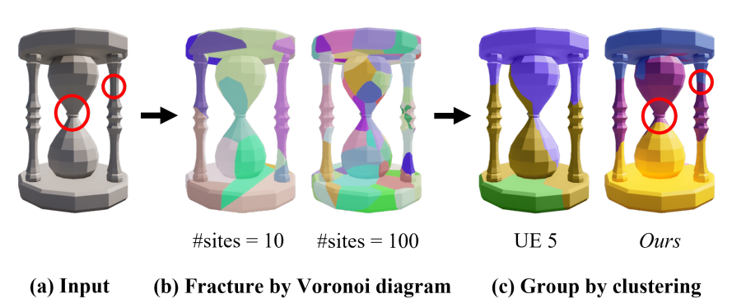
Prefracture Method
Elude runtime fully physics-based simulation
Generate fractured meshes at pre-runtime
Replace the original mesh upon impact at runtime

Slide 6
Prefracture Method
Remainder is the rigid body physics simulation
Which is very common in game world
Rigid body : solid object with zero deformation

Slide 7
Prefracture Method
A very clever solution!
It is realistic enough in many cases
But there are always tradeoffs

Slide 8
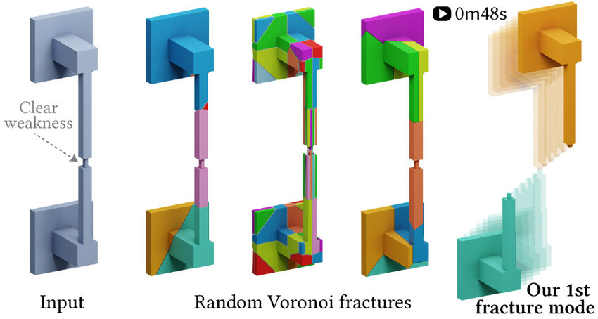
(Cons of) Prefracture Method
Simple prefracture meshes are randomly generated (Voronoi diagram)
They do not reflect its structure

Slide 9
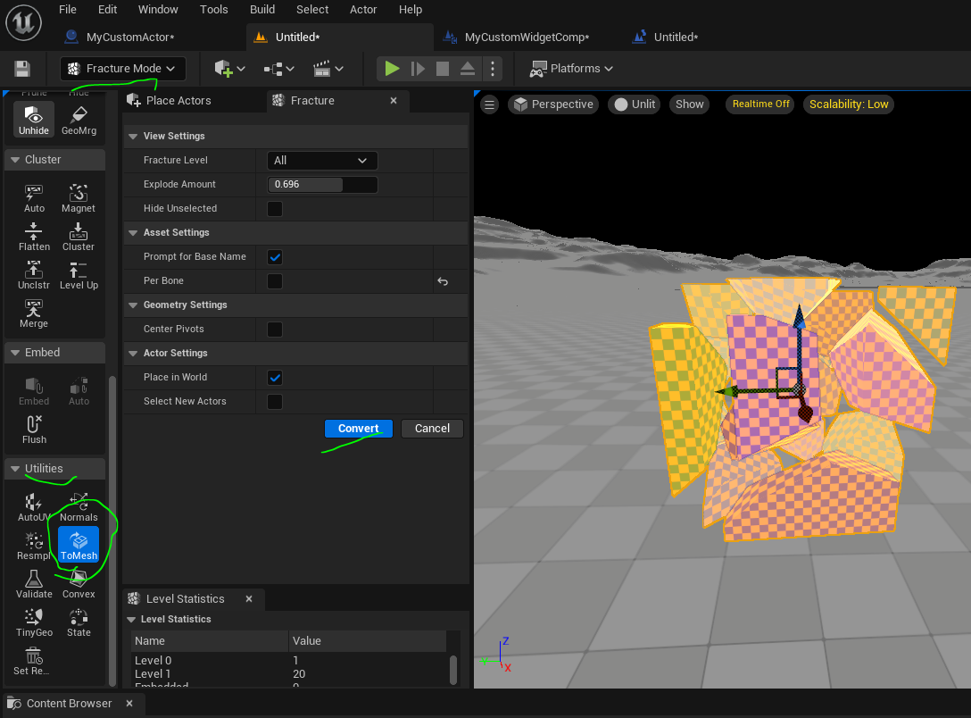
(Cons of) Prefracture Method
Heuristic clustering is introduced to refine them
Or an artist does it by hand (hundreds to thousands; really?)

Slide 10
Idea
Prefracture mesh generation is performed before runtime
It can be very slow
Okay, let us employ the magical neural network
Elude runtime fully physics-based simulation
Generate fractured meshes at pre-runtime
Replace the original mesh upon impact at runtime

Slide 11
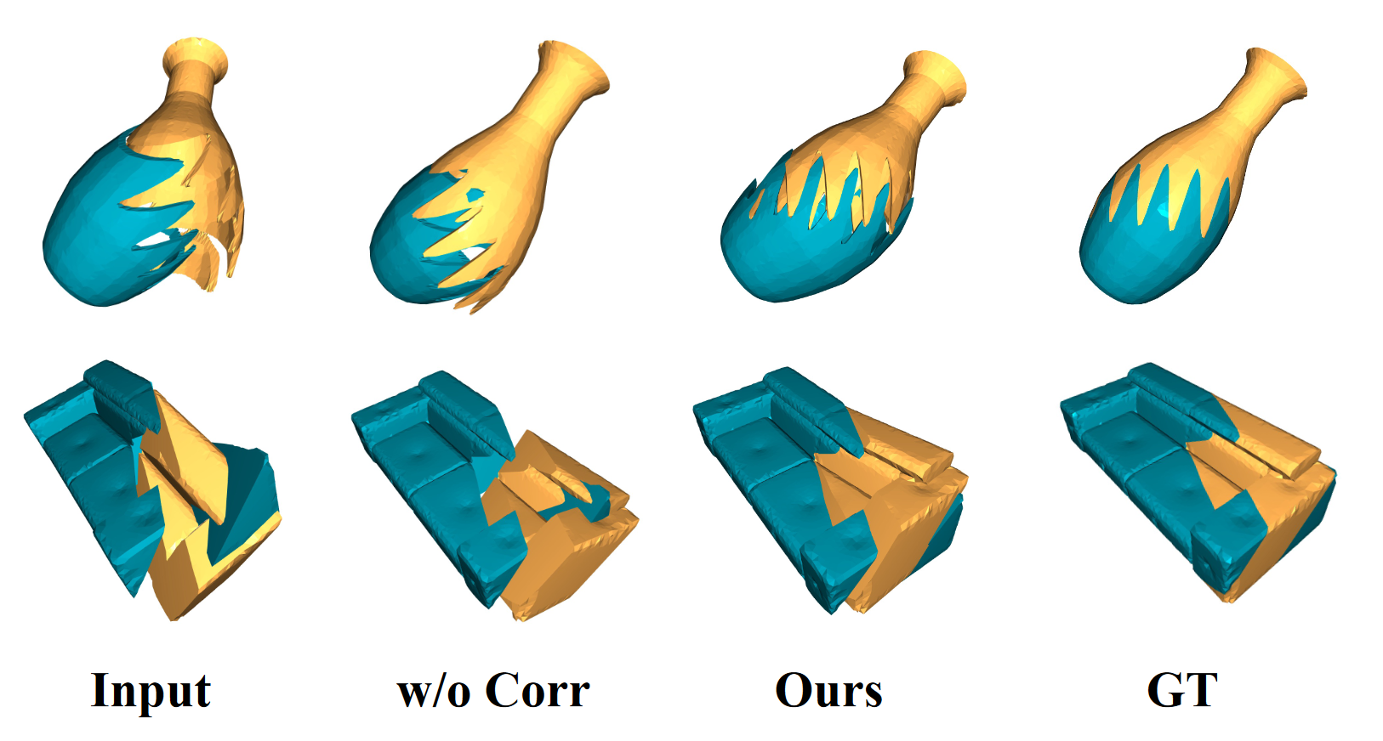
Problem: Dataset?
There has never been a task like this; there is no dataset!
I found out that there is a task called “3D assembly”

Slide 12
Problem: Dataset?
Flip the input and output

Slide 13
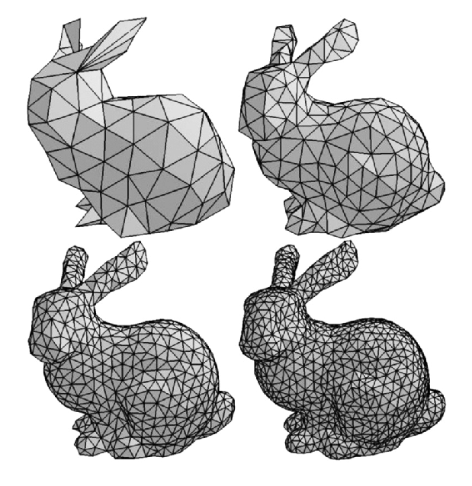
Problem: How to model?
It is very difficult to deal with mesh as is (how to do this?)
Also, widely used triangle meshes do not have “volume information”

Slide 14
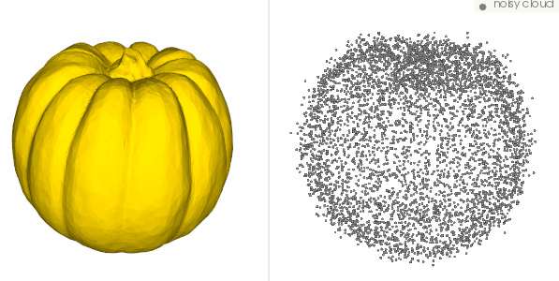
Problem: How to model?
I decided to convert it to a point cloud
Sample points appropriately within the mesh
The implementation is quite hard, so I take a detour

Slide 15
Problem: How to model?
Label them based on which fragment meshes in datasets

Slide 16
Problem solved?
Now we have point cloud and label
Just apply the point cloud segmentation model?
I used Point Transformer

Slide 17
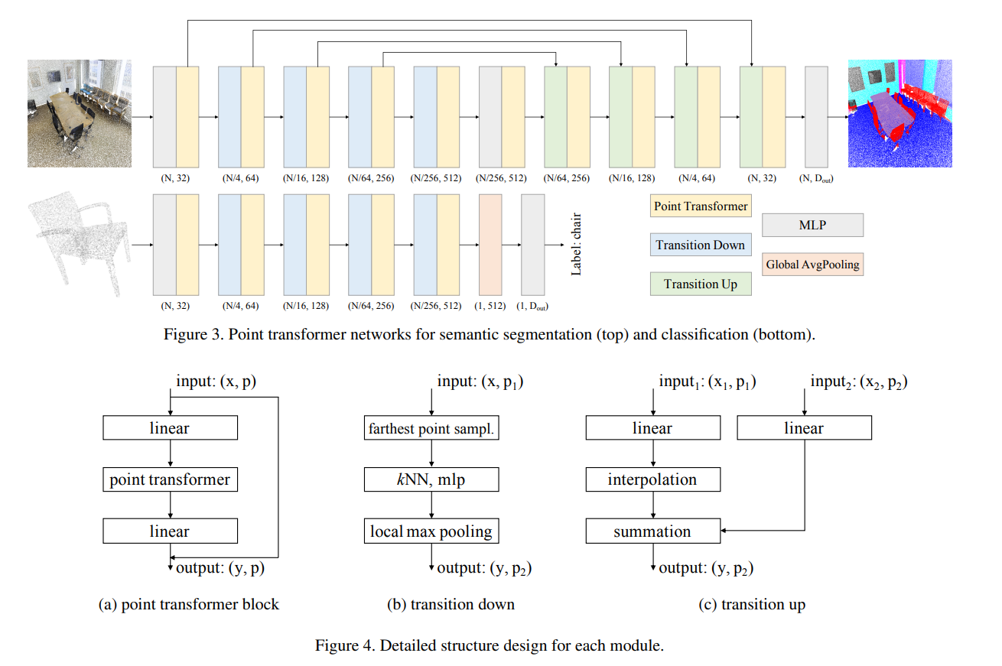
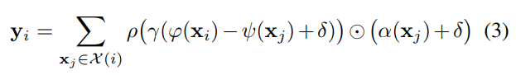
Point Transformer

Slide 18
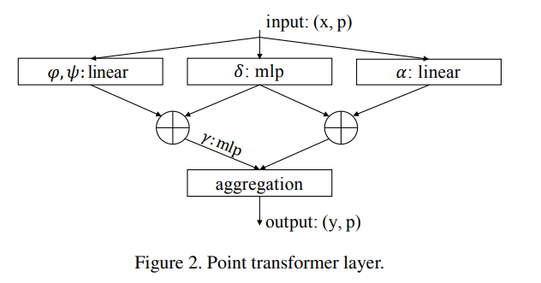
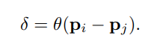
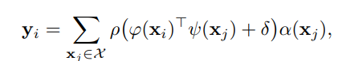
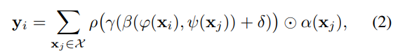
Point Transformer
Point transformer layer is their contribution

Slide 19
Problem solved?
If the number of label were different
Is the model making a mistake?

Slide 20
Unordered Label
The numerical value of label is meaningless!
Only the identity relationship is significant

Slide 21
Unordered Label
So the loss needs to be permutation-invariant to label number
Remember the points in a point cloud are permutation-invariant
Ground truth label = [0, 0, 3, 1, 3]
Predicted label = [1, 1, 6, 0, 6]
The permutation of values, not the permutation of indices
It is a bit odd; is there a better way to put it?

Slide 22
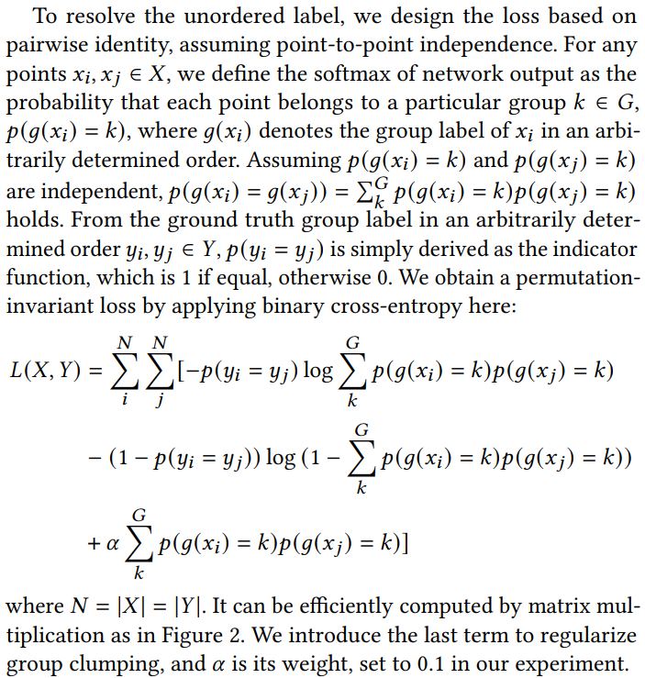
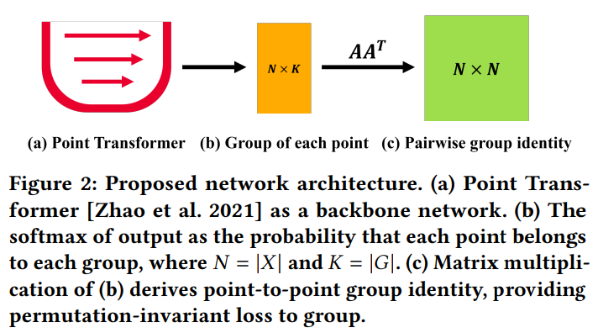
Loss Modeling

Slide 23
Loss Modeling

Slide 24
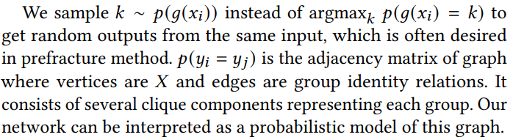
Loss Modeling

Slide 25
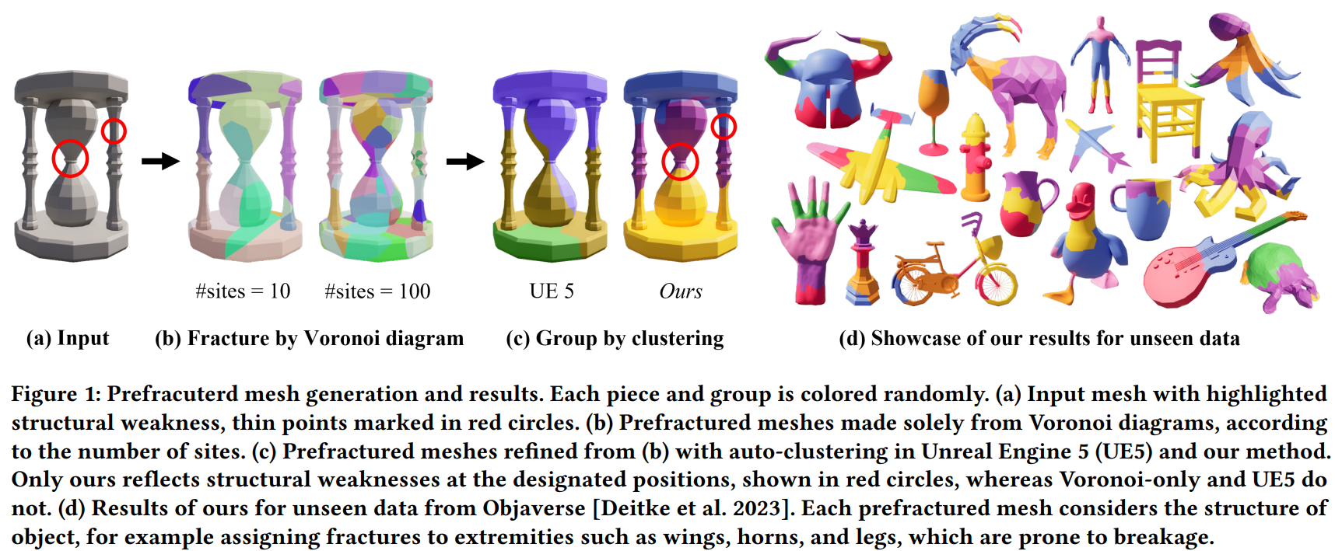
Results

Slide 26

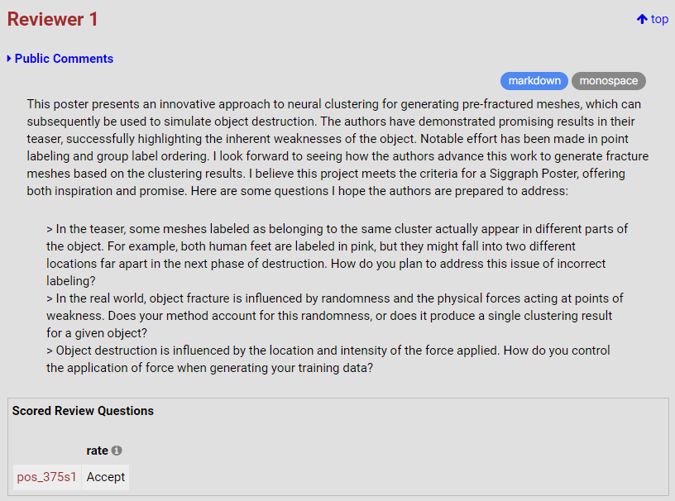
Review 1

Slide 27
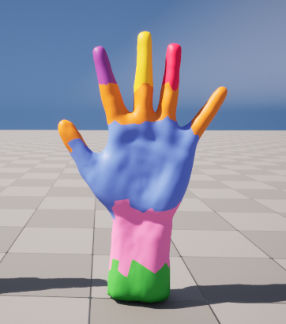
Review 1

Slide 28
Review 1

Slide 29
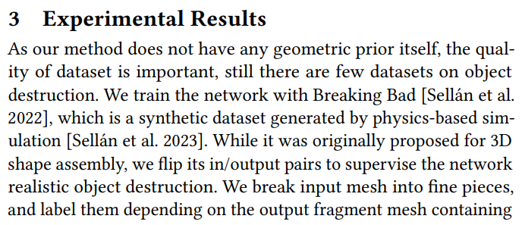
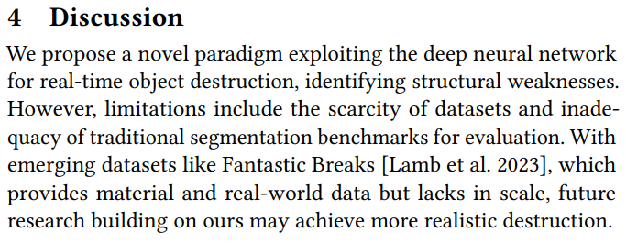
Review 1

Slide 30
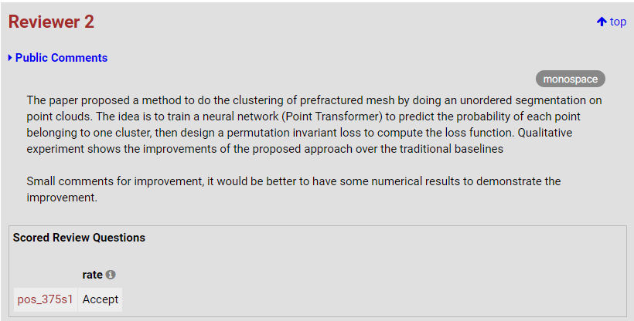
Review 2
It is hard to evaluate with IoU or something…

Slide 31
Thank you for listening
Presenter: Kim Seung Hwan (overnap@khu.ac.kr)

Slide 32
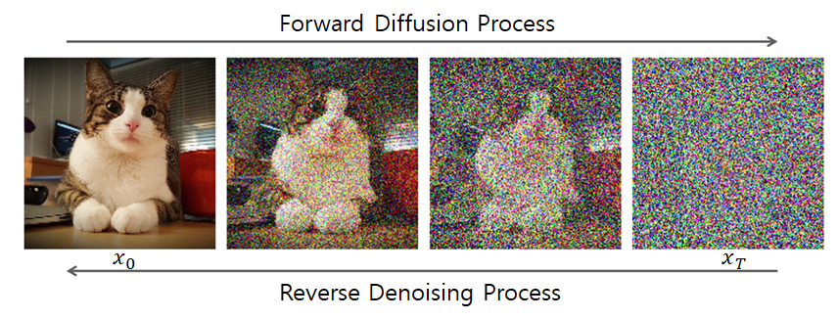
Preview: Continuous Diffusion
Discrete diffusion model has appeared in many seminars
Takeaways: sum of Gaussians is Gaussian & loss derivation

Slide 33
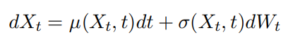
Preview: Continuous Diffusion
Stochastic Differential Equation (SDE)

Slide 34
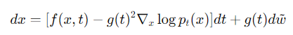
Preview: Continuous Diffusion
Reverse SDE
Oh, this is exactly the same as the diffusion!

Slide 35
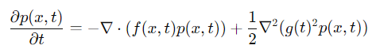
Preview: Continuous Diffusion
But why?
Anderson’s theorem
Fokker-Planck Equation
Kolmogorov backward equations
…

Slide 36
Preview: Continuous Diffusion
Still difficult
See you next time~

Slide 37
Thank you for listening
Presenter: Kim Seung Hwan (overnap@khu.ac.kr)

